Slide 1


Aaron J. Hill¹ and Russ S. Schumacher²
AI and Machine Learning in NWP: A look at Excessive Rainfall with the CSU-MLP
¹School of Meteorology, University of Oklahoma
²Department of Atmospheric Science, Colorado State University
Along with NOAA partners: Mark Klein and Jim Nelson (WPC)
And contributions from Allie Mazurek (CSU) and Hanna McDaniel (FSU)
Research supported by NOAA JTTI grant NA21OAR4590187
Winter Weather Workshop, NWS OKX WFO
November 2023

Slide 2
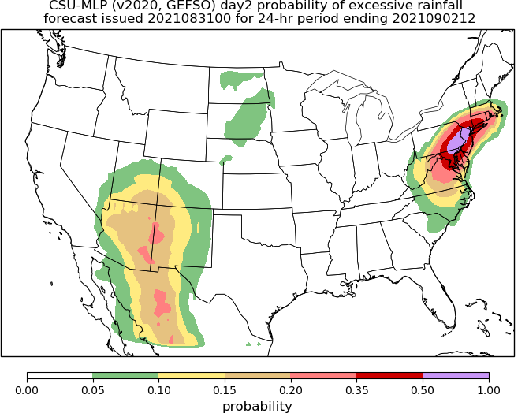
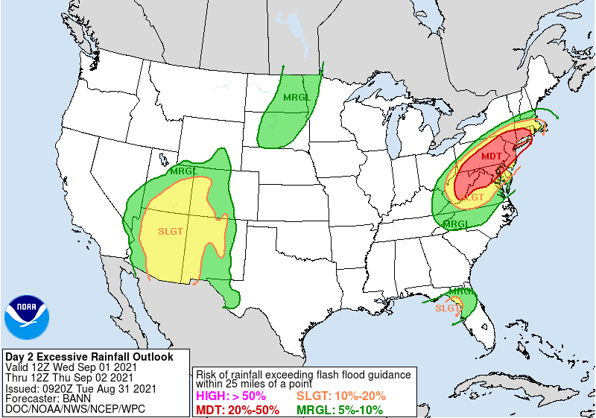
Background
FIRST GUESS
NOAA Weather Prediction Center forecasters routinely issue Excessive Rainfall Outlooks (EROs), indicating regions with the potential for flooding rains across the continental US on days 1-3
Since 2017, we have developed and tested probabilistic forecasts that apply machine-learning techniques to a reforecast ensemble to help give guidance to WPC forecasters -- a “first guess” when producing these outlooks
Several versions of the forecast system based on the GEFS are now running operationally at WPC
WPC ERO
Real-time forecast graphics: http://schumacher.atmos.colostate.edu/hilla/csu_mlp/
Schumacher et al. (2021, BAMS)

Slide 3
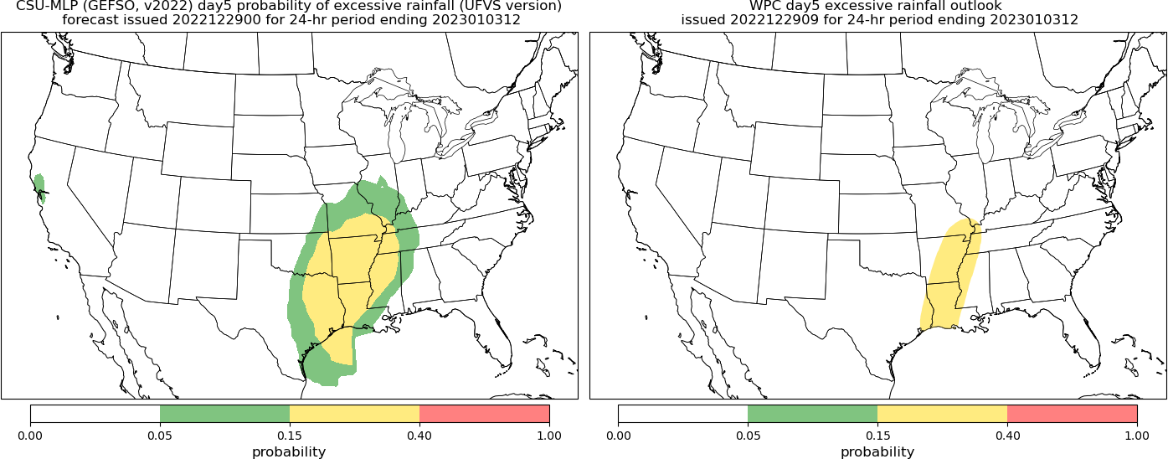
Background
FIRST GUESS
In 2022, WPC began issuing experimental day 4-5 EROs, which are not operational
The CSU-MLP precipitation forecasts have been extended to 8 days, similar to severe weather guidance products (Hill et al. 2023, WAF)
But is there actual forecast skill at these lead times?
What is the best definition of excessive rainfall?
WPC ERO

Slide 4
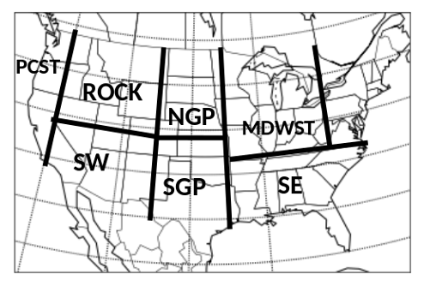
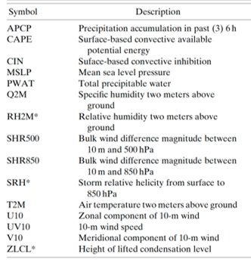
The approach
Data: NOAA’s FV3-GEFS Reforecast Dataset (Hamill et al. 2022): 5 members, matches current GEFSv12
Use many atmospheric fields as predictors (the ensemble median), train random forest models over 8 regions
We use Jan 2003 – August 2013 as the training period (~10 yrs)
Probabilistic forecasts mimic the ERO categories/definitions
Observations to define excessive rainfall...
See Schumacher et al. (2021); also Herman and Schumacher 2018a,b) and Hill and Schumacher (2023, in prep) for more details

Slide 5
We want to predict excessive rainfall…but what is excessive rainfall?
A primary motivation for this approach is that forecasters need probabilistic information about the rarity of upcoming rainfall. But...
We have accepted (if flawed) definitions of tornado, severe hail, severe winds – but nothing analogous for excessive rainfall
Exceeding flash flood guidance?
Produces a flash flood report?
More than a certain threshold? (and if so, which one(s)?)
What quantitative precipitation estimate to use?

Slide 6
What are we trying to predict?
We have chosen to use two frameworks/datasets:
1) “fixed frequency” – or in other words, we use climatological average recurrence intervals (ARIs) to define a heavy or extreme rain event
Better corresponds to actual impacts in a given region than a fixed threshold
Doesn’t bias the verification statistics toward climatologically wet regions
Use the NCEP Climatology-Calibrated Precipitation Analysis (CCPA) to identify historical exceedances of the various average recurrence intervals (1 and 2 yr) for 24-hour rainfall accumulation
NCEP Stage-IV adjusted dataset
2) Unified Flood Verification System (Erickson et al. 2019,2021)
Flash flood reports, exceedances of FFG or the 5-yr ARI, and reports of flooding from USGS stream gauges, MPING

Slide 7
Machine Learning Framework
Meteorological Variables
3-h accumulated precipitation
CAPE
Precipitable water
Deep layer shear
…
The model learns to associate rainfall events with certain meteorological conditions
(analogous to ingredients-based forecasting; Mazurek et al. 2023)
Machine Learning Model
Historical Events
Fixed-frequency dataset or
UFVS dataset

Slide 8
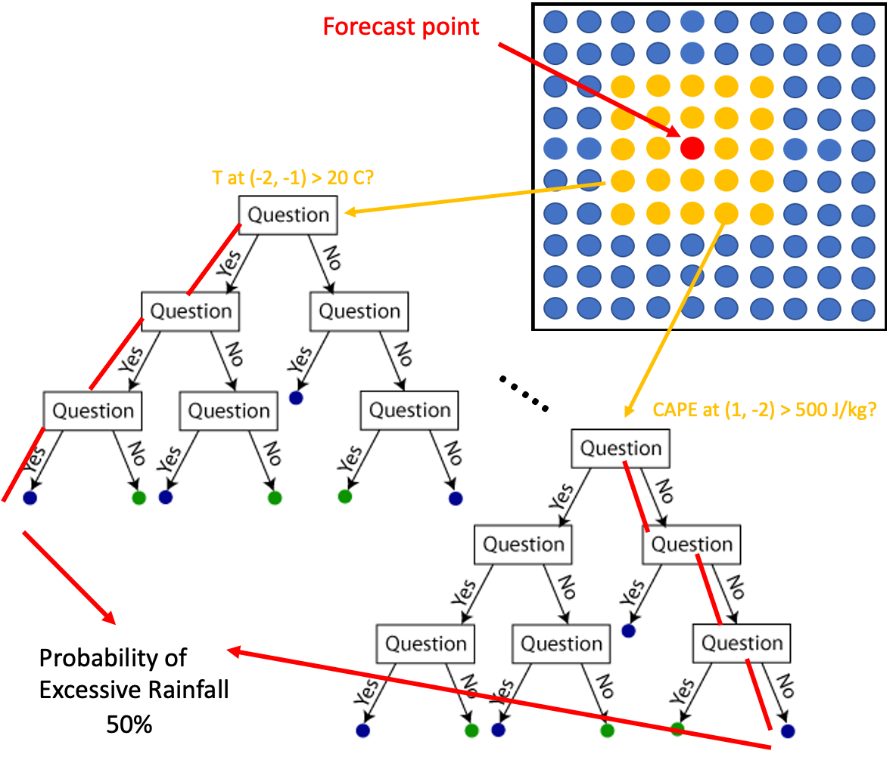
Random Forest Primer
A set of decision trees that contain a series of yes/no questions (branches) based on input predictors that allow traversal of the tree
Corresponding events of excessive rainfall are assigned to the “leaf” nodes
Relative frequency of events in the forest is the forecast probability
Python package "determines" best predictors that discriminate events
Probability of rain 50%

Slide 9
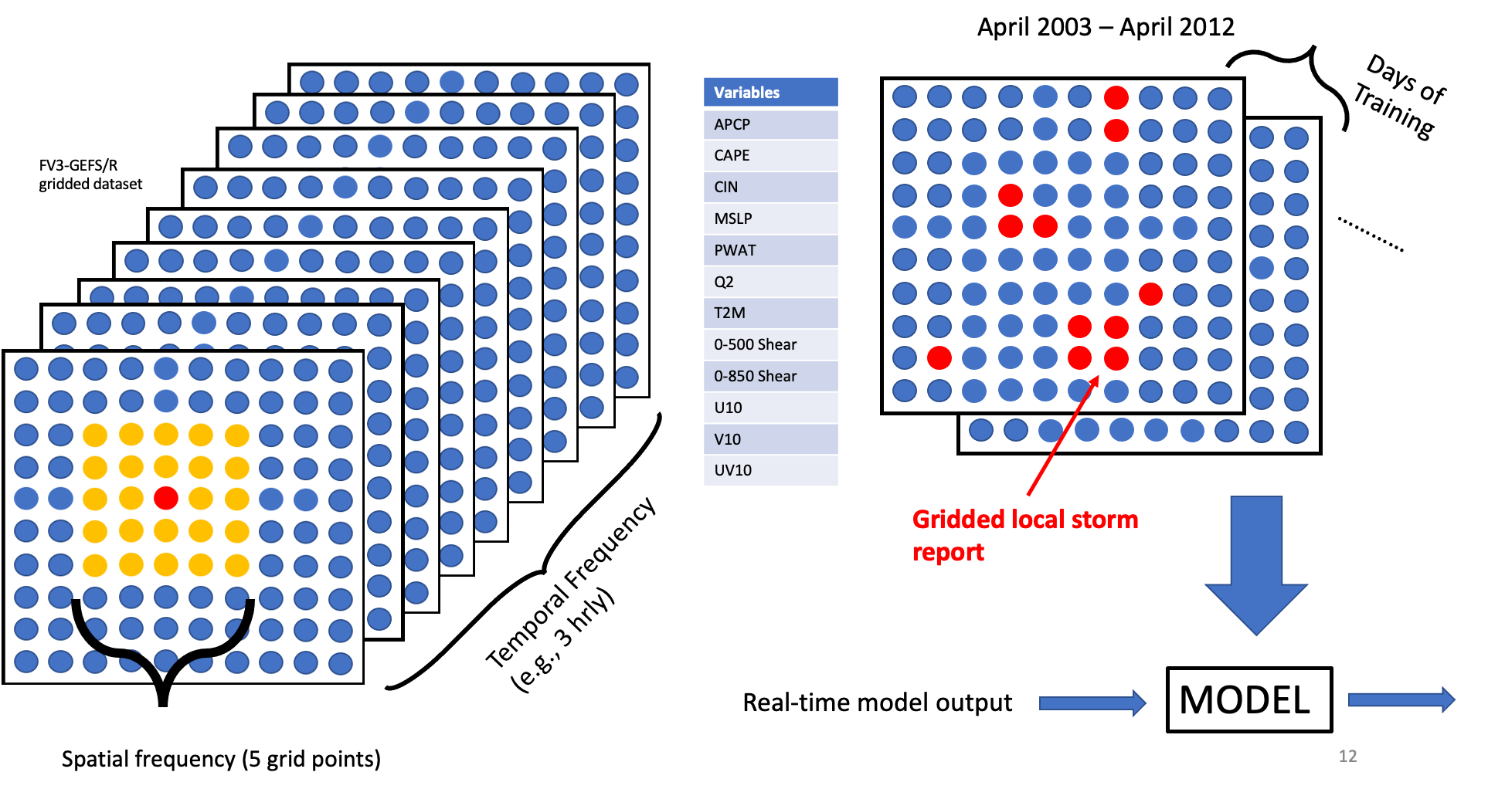
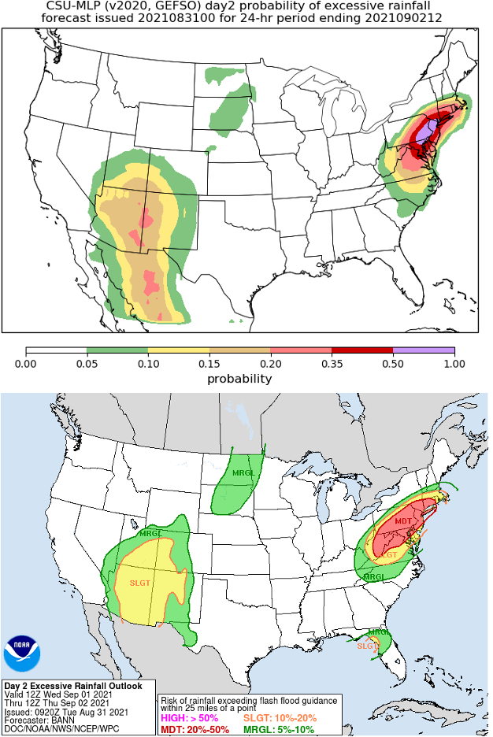
Random Forest Configuration
Gridded rainfall
observation

Slide 10
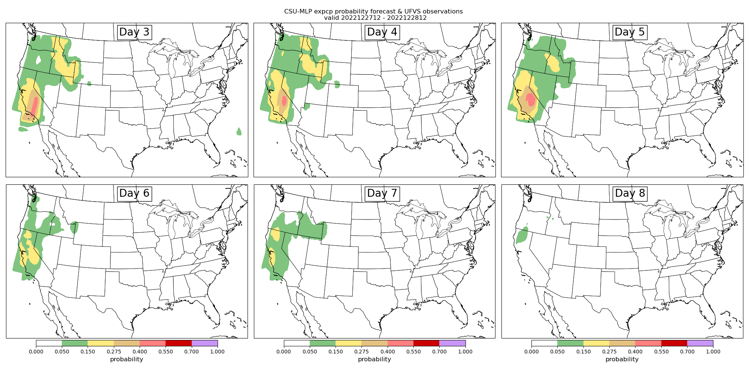
Good forecast example: 27-28 December 2022 (California flooding)
Fixed frequency model
Day 3
Day 4
Day 5
Day 6
Day 7
Day 8

Slide 11
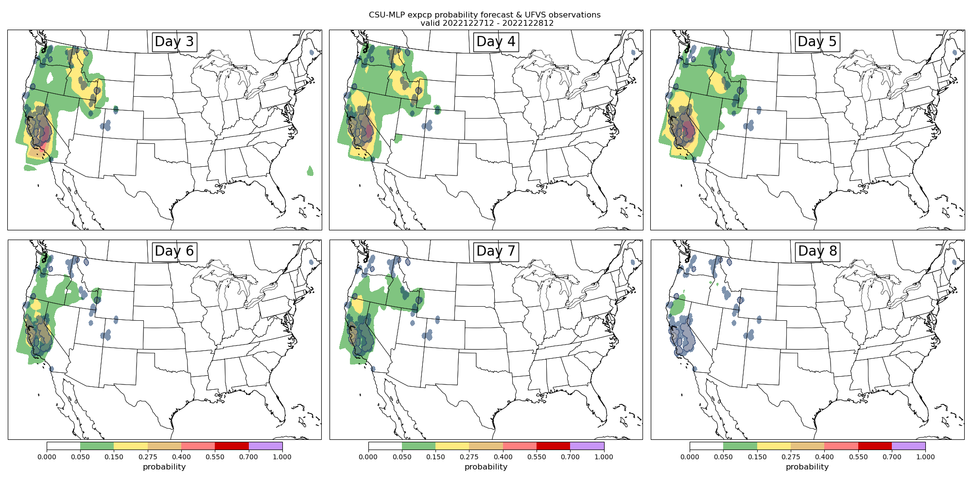
Good forecast example: 27-28 December 2022 (California flooding)
Day 3
Day 4
Day 5
Day 6
Day 7
Day 8

Slide 12
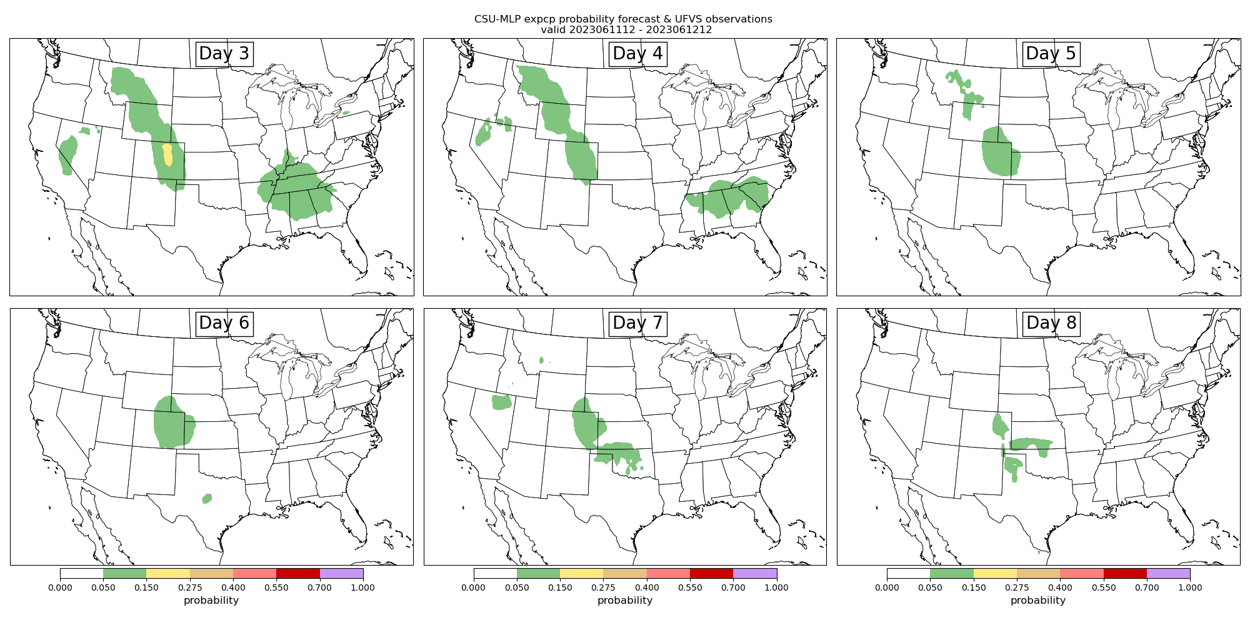
Good forecast example: 11-12 June 2023 (Colorado flash flooding)
Fixed frequency model
Day 3
Day 4
Day 5
Day 6
Day 7
Day 8

Slide 13
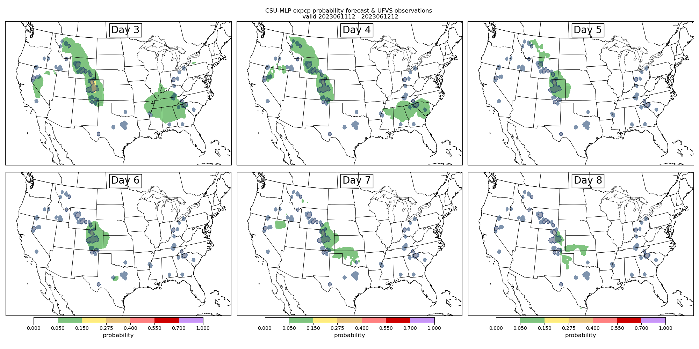
Good forecast example: 11-12 June 2023 (Colorado flash flooding)
Day 3
Day 4
Day 5
Day 6
Day 7
Day 8

Slide 14
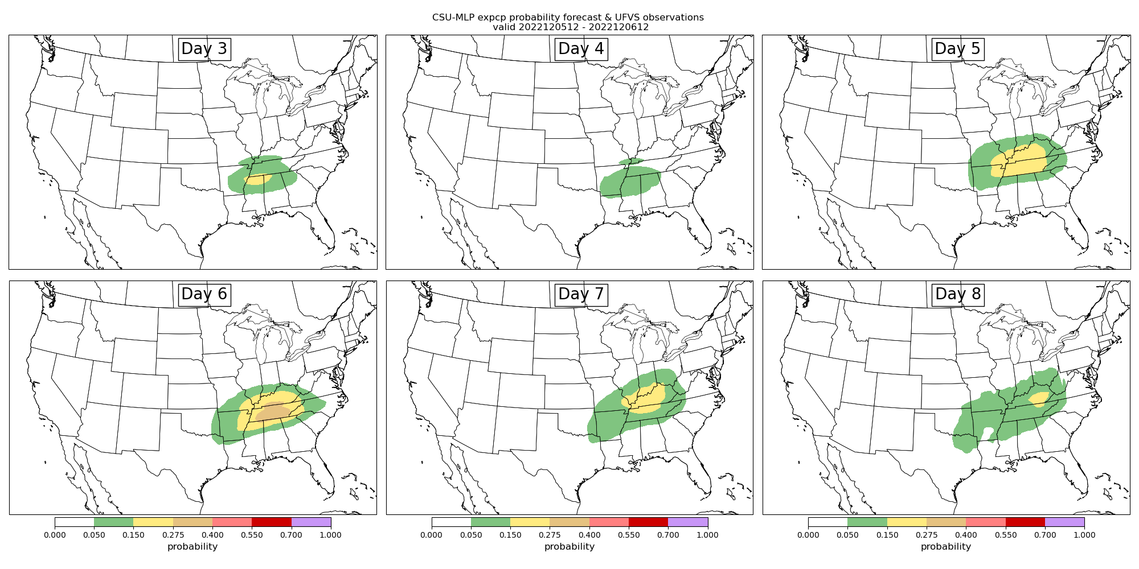
Poor forecast example: 5-6 December 2022
Day 3
Day 4
Day 5
Day 6
Day 7
Day 8

Slide 15

Poor forecast example: 5-6 December 2022
Day 3
Day 4
Day 5
Day 6
Day 7
Day 8

Slide 16
Verification methods
Two versions of CSU-MLP forecasts were run retrospectively from October 2020 through August 2023
Forecasts evaluated against WPC’s Unified Flood Verification System (Erickson et al. 2019, 2021), includes flash flood guidance exceedances, 5-yr ARI exceedances, flash flood LSRs, USGS and MPING flood reports
For all forecasts, we use the “new” definitions for ERO probabilities: 5, 15, 40, 70%

Slide 17
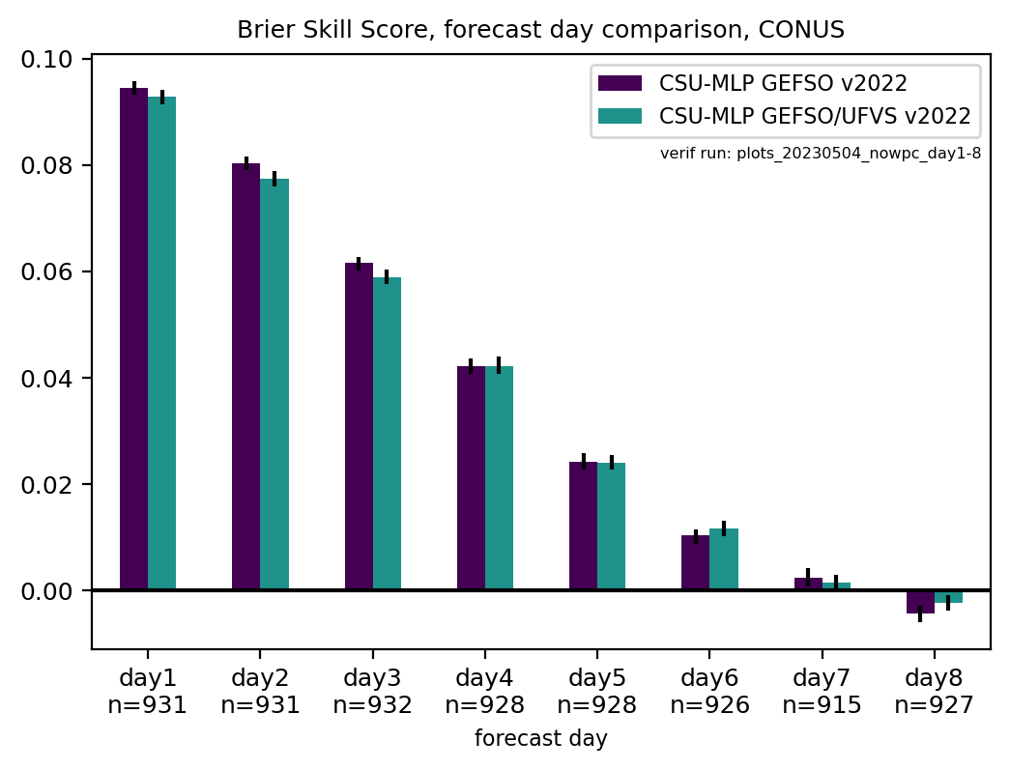
Brier skill score with respect to smoothed daily climatology, higher is better
~2.5 years of forecasts (Oct 2020-Apr 2023)
Forecasts are skillful out to at least 6 days

Slide 18
Brier skill score with respect to smoothed daily climatology, higher is better
~3 years of forecasts (Oct 2020-September 2023)
WPC maintains superior day 1 skill

Slide 19
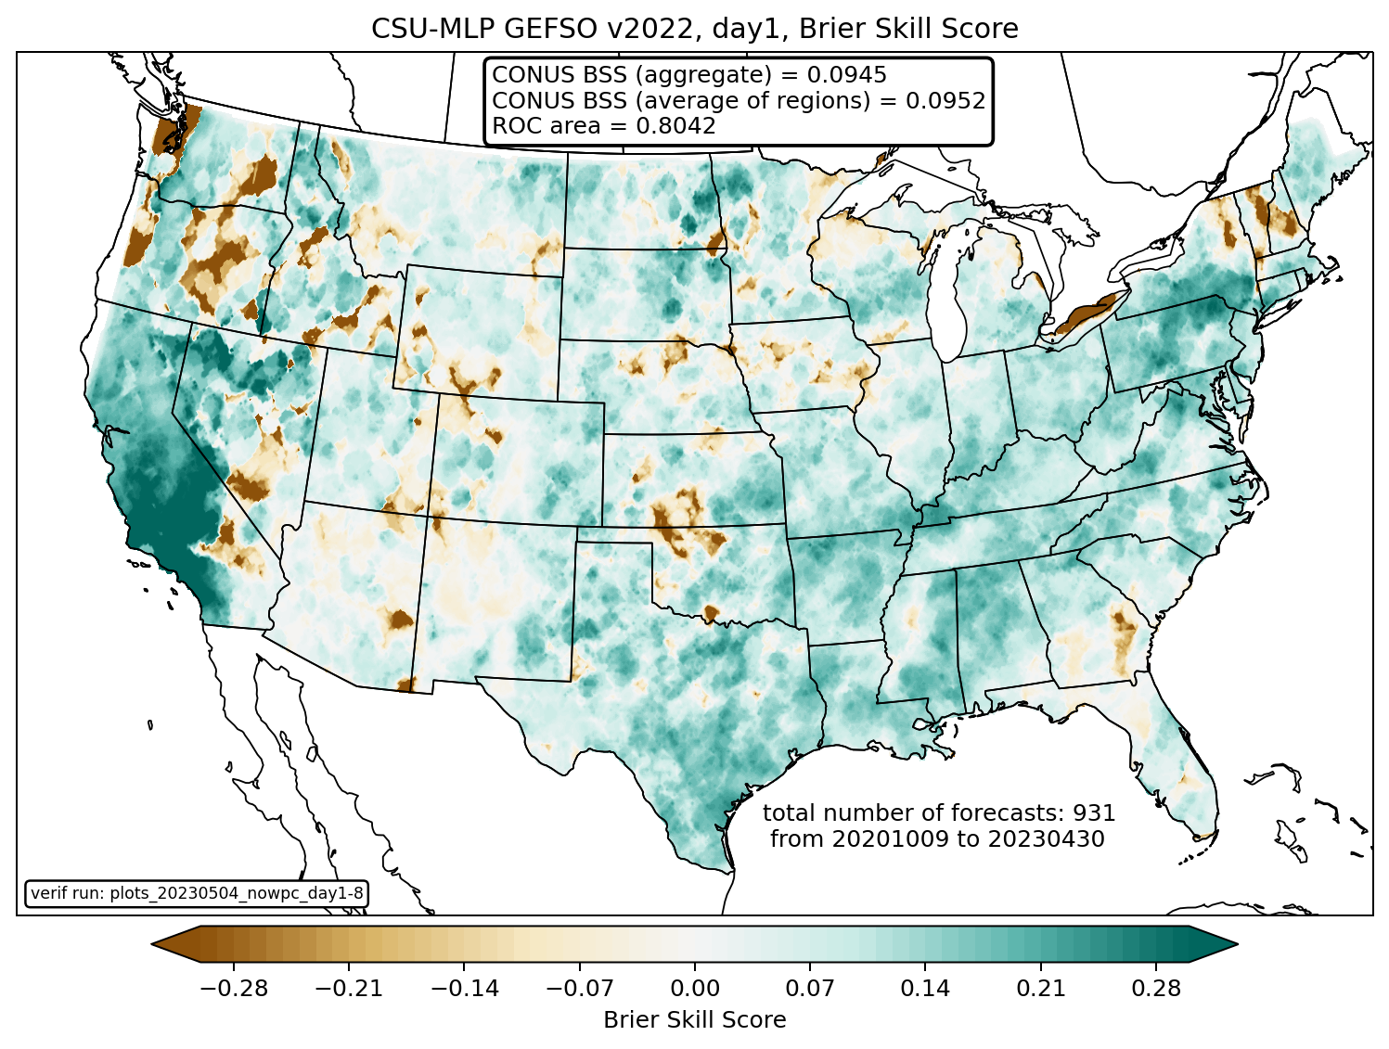
Day 1
Fixed frequency model

Slide 20
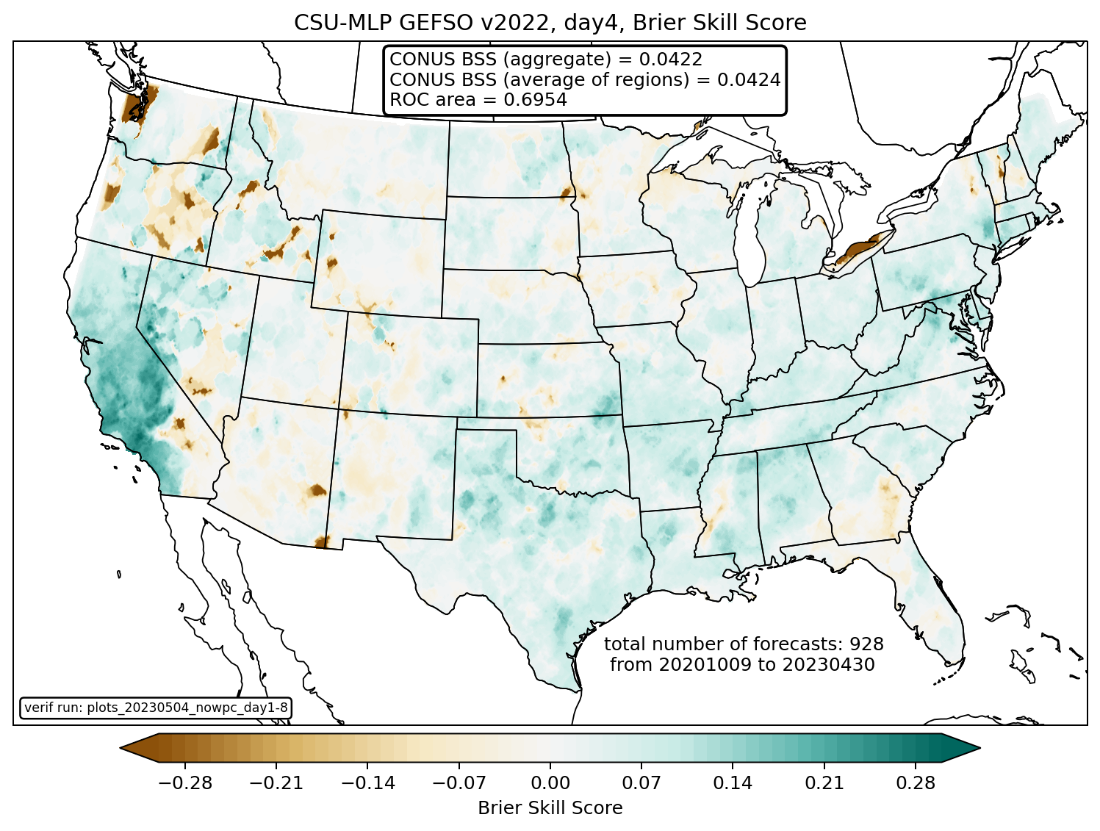
Day 4
Fixed frequency model

Slide 21
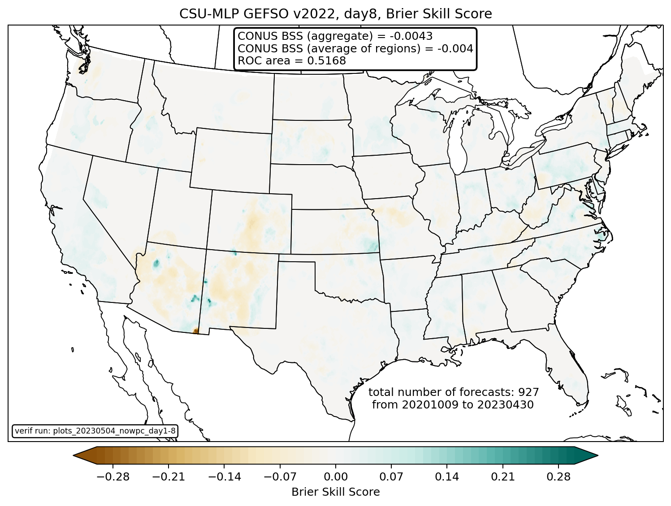
Day 8
Fixed frequency model

Slide 22
Brier skill score, by month
CONUS
NE
Day 1
Higher is better
Day 1
- clear seasonality to skill that decreases during the warm season
- at longer lead times WPC ERO skill is indistinguishable from ML models (except for cool season events)
- In the NE, all systems show considerable skill outside of late winter/early spring
Climatology forecast
Day 2
Day 2
Climatology forecast
Day 3
Day 3
Climatology forecast

Slide 23
The future: partly cloudy?
‘’Fixed frequency” models have been transitioned to WPC operations, after recommendation from FFaIR last year
We anticipate the UFVS-trained models will also be transitioned to operations (ongoing)
Under current situation, no further support for CSU-MLP beyond December 2023
So future development is unclear – but we still have plenty of ideas!

Slide 24
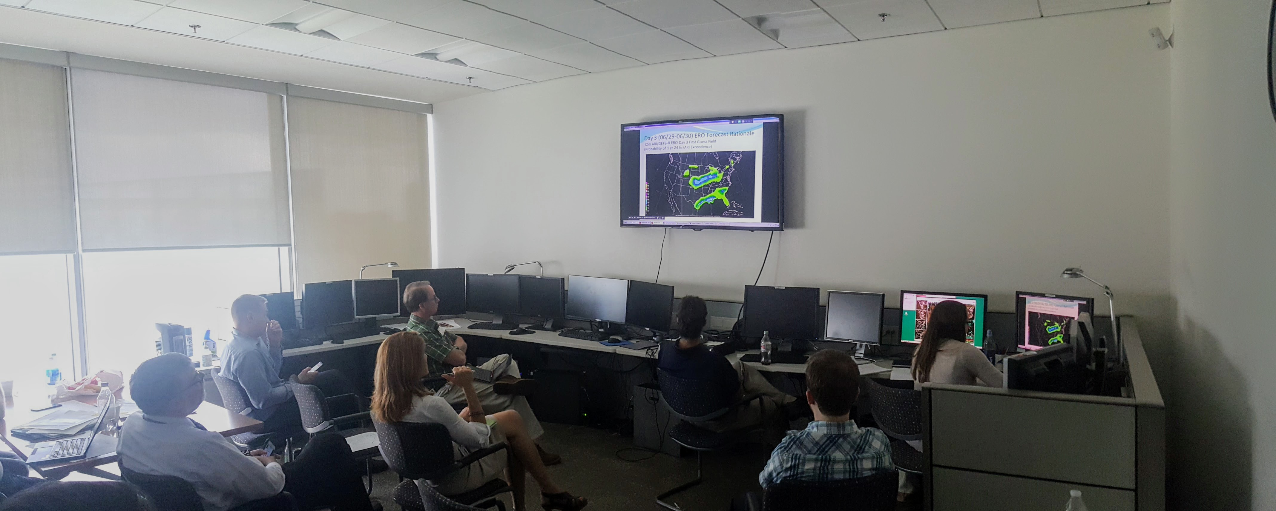
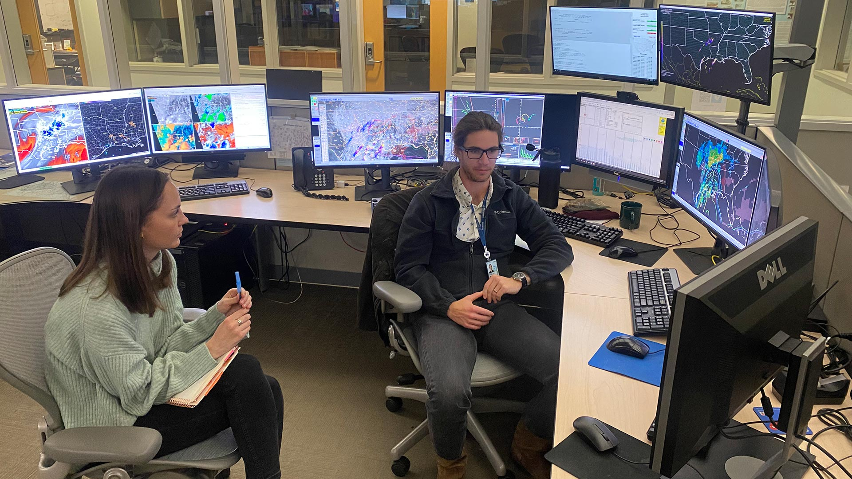
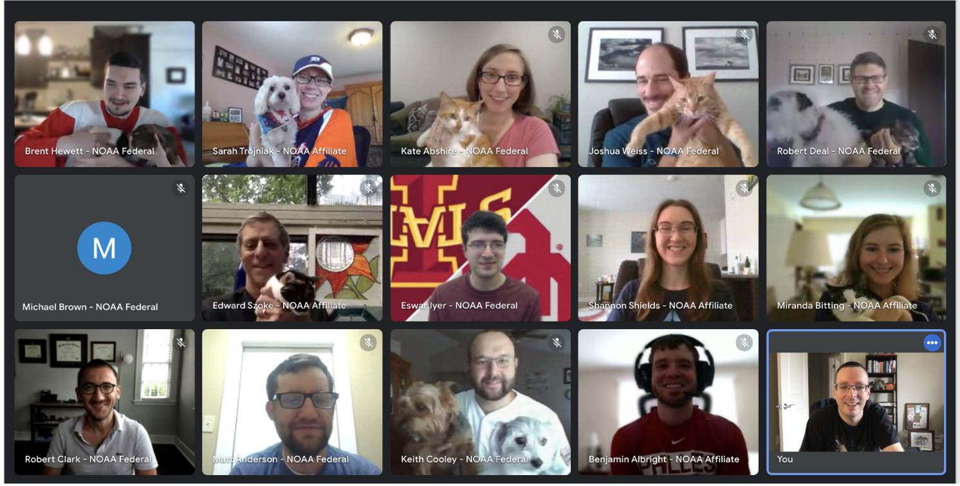
Collaboration with forecasters has been key to the improvement of these systems!

Slide 25

Summary
Machine learning techniques can help in post-processing NWP output to yield useful “first guess” guidance for operations
ML models for excessive rainfall are skillful beyond day 1, but current approaches reach a limit by day 6
Plenty of opportunities for further advances, both in the forecasts themselves, and how they can be applied: what’s the best way to make them useful and trustworthy for forecasters?
Thank you!
ahill@ou.edu
russ.schumacher@colostate.edu
Real-time forecast graphics: http://schumacher.atmos.colostate.edu/hilla/csu_mlp/
Contact us if interested in gridded output!

Slide 27
Backup slides

Slide 28
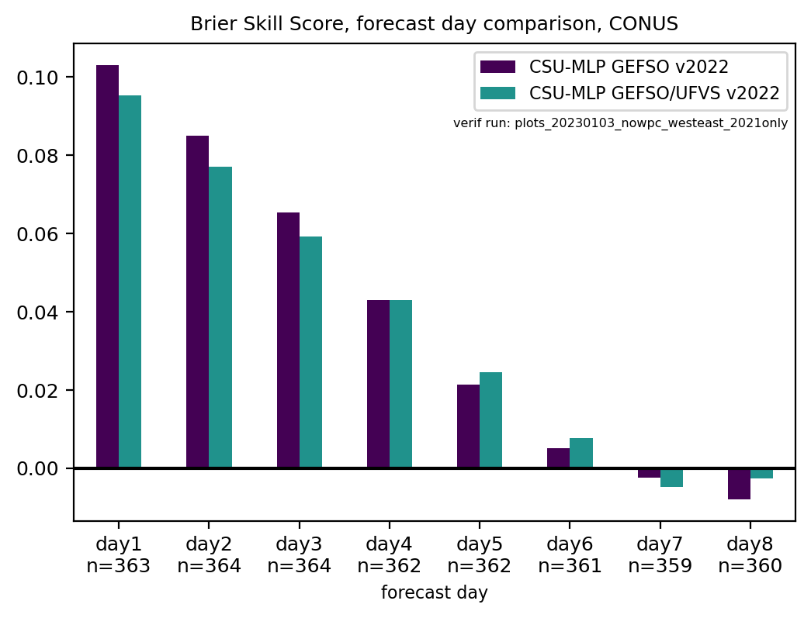
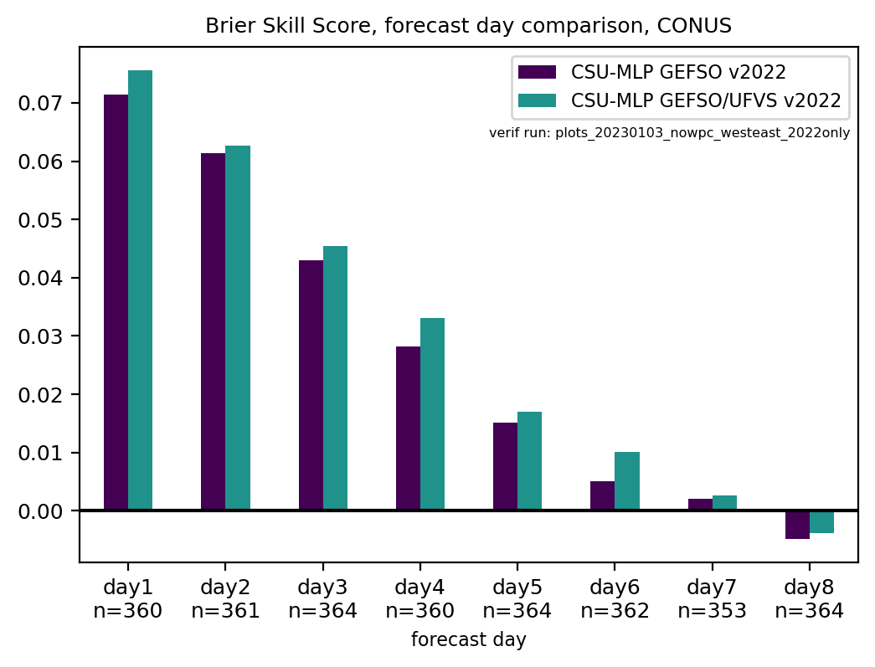
Brier skill score and ROC area, CONUS, by day and year
2021
2022
UFVS models more skillful days 1—4 in 2022 compared to 2021
Consistent with impressions from participants in the 2022 HMT FFaIR experiment
More active monsoon?
There may be regimes, seasons, and regions in which one model is more skillful

Slide 29
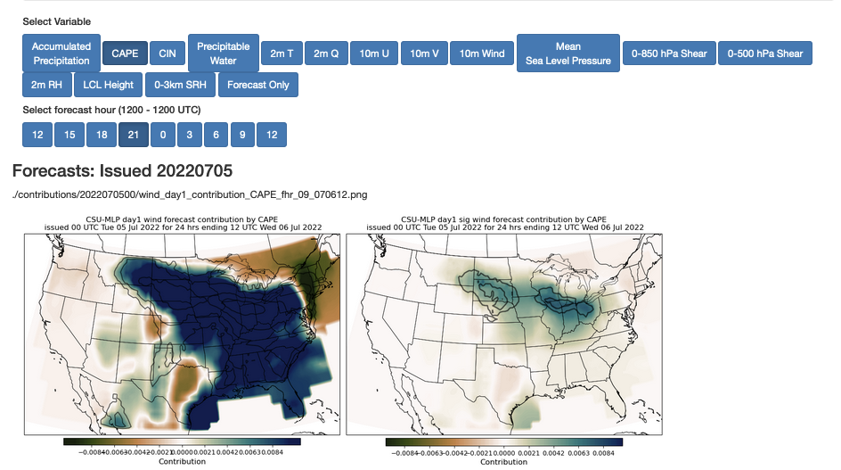
Ongoing work: diagnosis of how environmental parameters are influencing the forecast
Work by grad student Allie Mazurek and
REU student Hanna McDaniel, using Tree Interpreter package

Slide 30
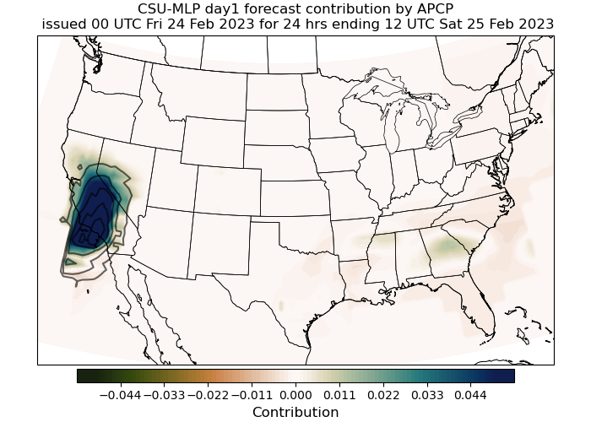
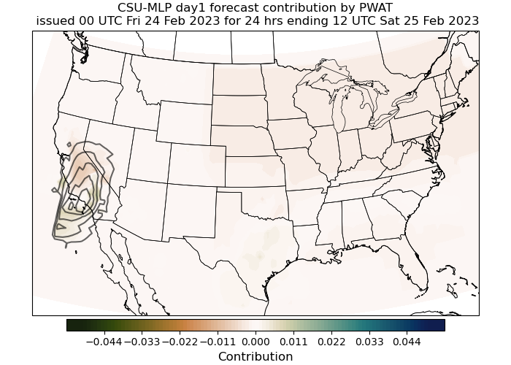
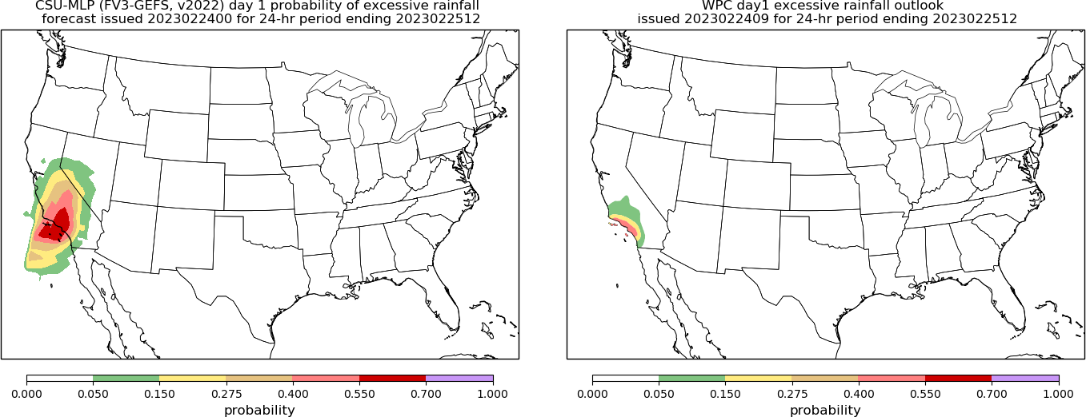
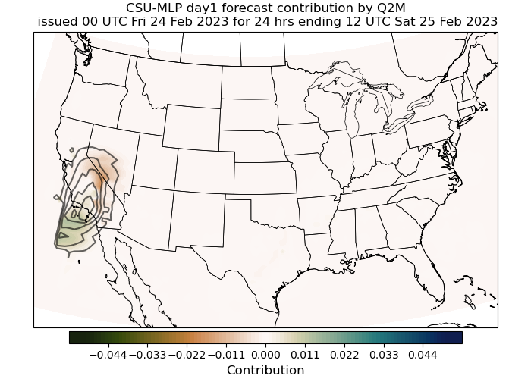
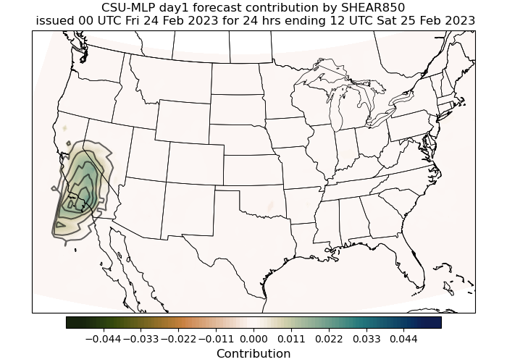
Ongoing work: diagnosis of how environmental parameters are influencing the forecast
Example: Day-1 forecast contributions
for 24 February 2023 at forecast hour
0000 UTC
Can spatially interpret which fields are
supplying key information to the fore-
cast probabilities
Negative
Contribution
Positive Contribution

Slide 31
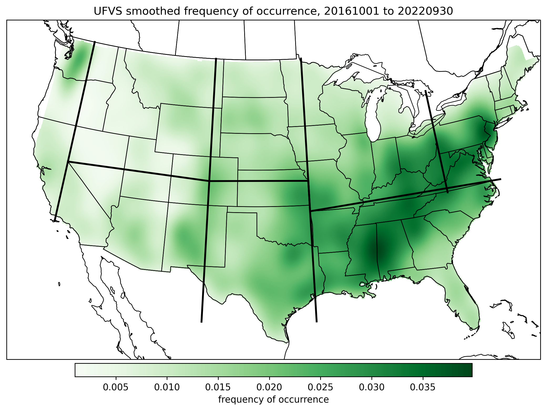
Verification of CSU-MLP excessive rainfall forecasts
Observation dataset is WPC’s UFVS, includes flash flood guidance exceedances, 5-yr ARI exceedances, flash flood LSRs, USGS and MPING flood reports
Retrospective forecasts run back to 2 October 2020 (when GEFSv12 became operational) through 31 May 2022.
Verification is done CONUS-wide and for the western/eastern US
Comparison is to 09Z WPC operational EROs
All evaluation uses the new definitions for ERO categories: 5, 15, 40, 70%

Slide 32
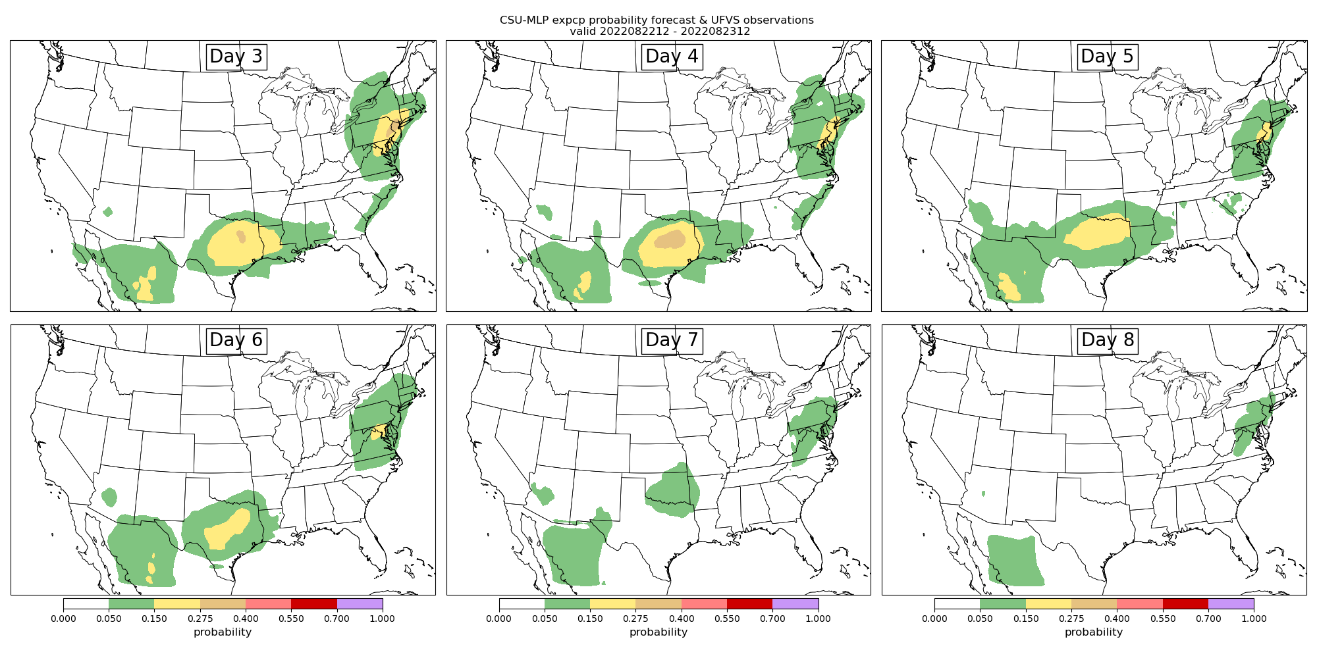
Good forecast example: 22-23 August 2022 (Texas & northeast flooding)
Day 3
Day 4
Day 5
Day 6
Day 7
Day 8

Slide 33
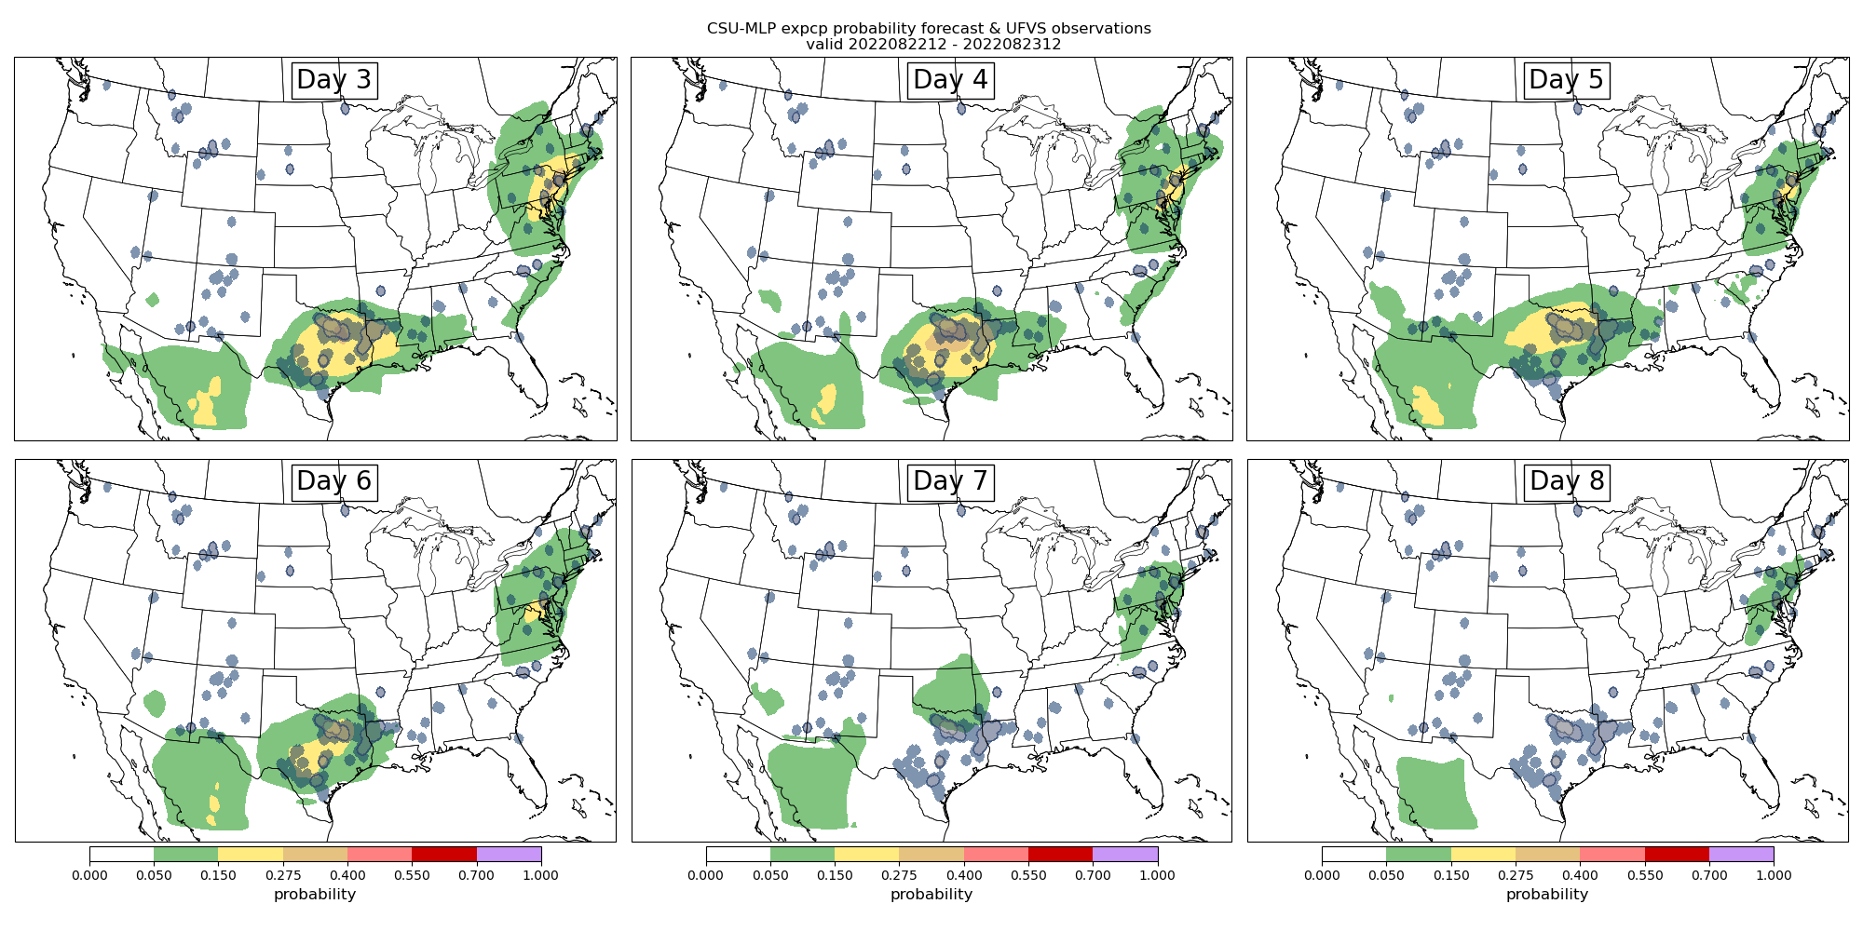
Good forecast example: 22-23 August 2022 (Texas & northeast flooding)
Day 3
Day 4
Day 5
Day 6
Day 7
Day 8

Slide 34
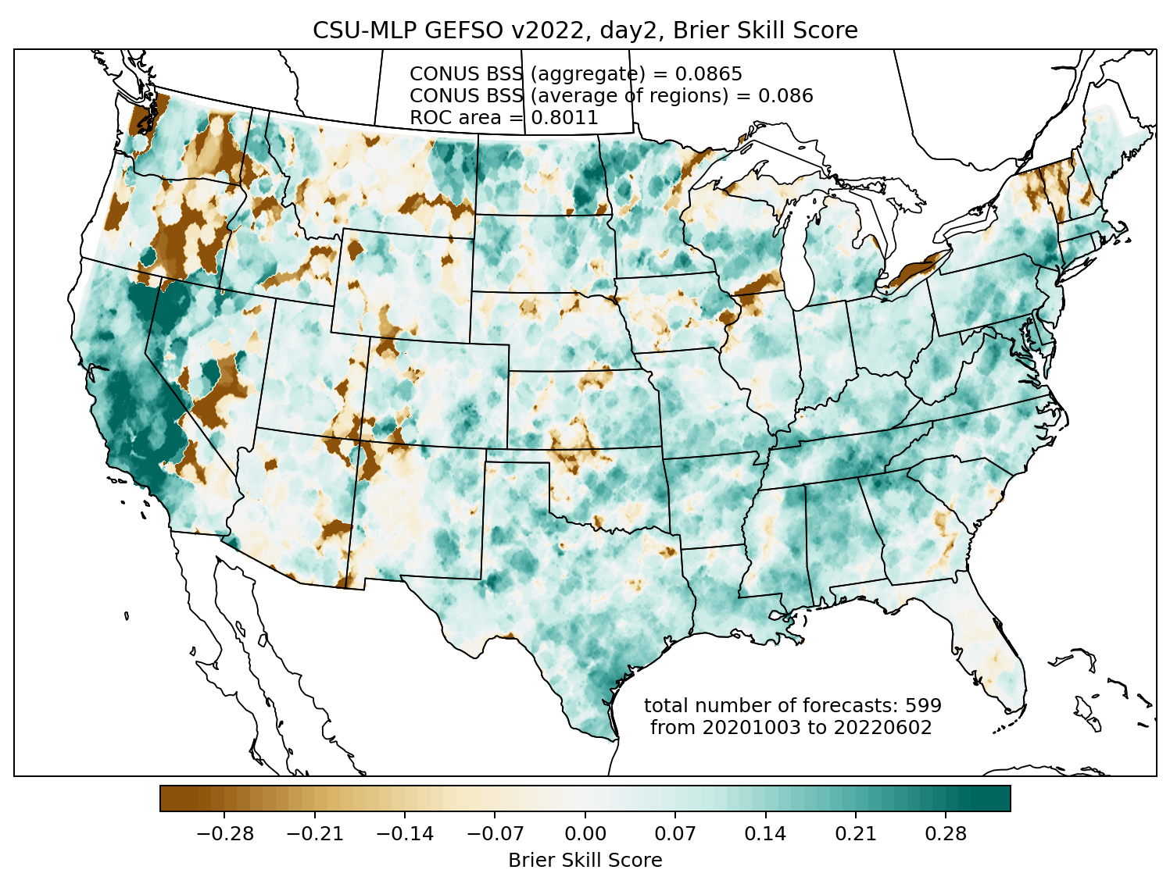
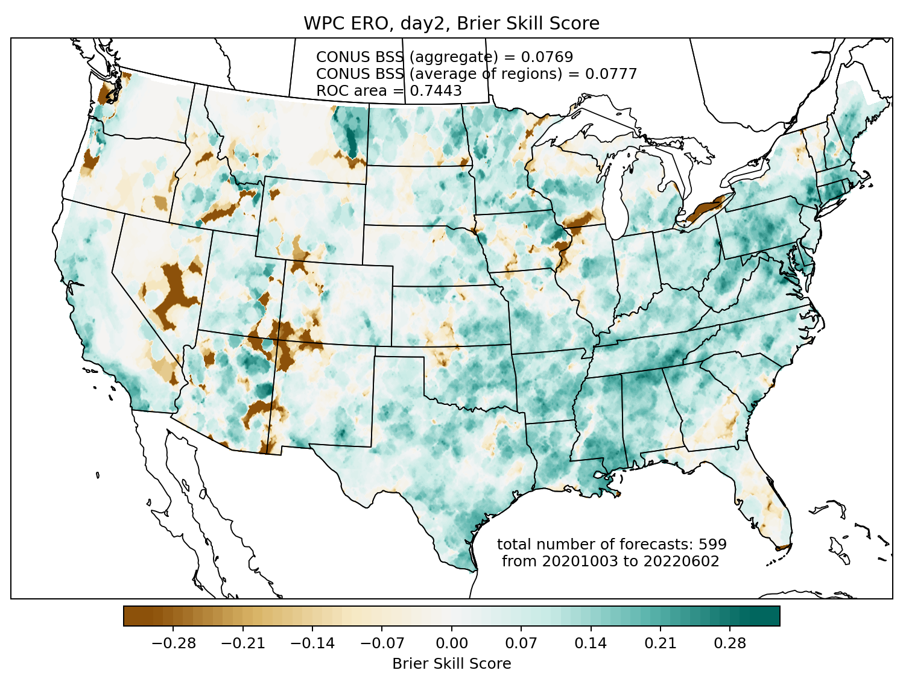
Brier skill score comparison: day 2
CSU-MLP (v2022)
WPC ERO
CONUS Brier Skill Score: 0.0865
CONUS Brier Skill Score: 0.0769

Slide 35
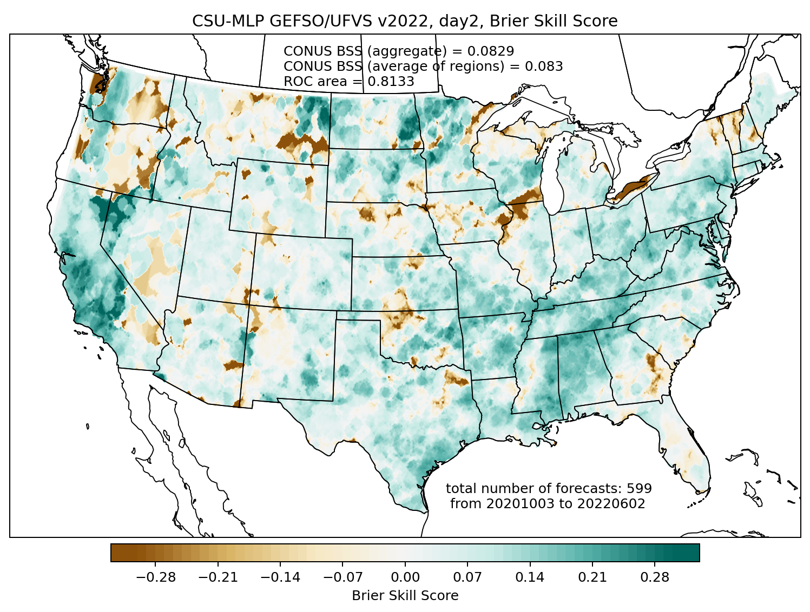
Brier skill score comparison: day 2
CSU-MLP (v2022, UFVS-trained)
WPC ERO
CONUS Brier Skill Score: 0.0829
CONUS Brier Skill Score: 0.0769

Slide 36
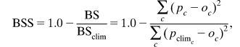
Calculation of forecast skill
The Brier Skill Score is used to assess forecast skill:
Here, we use a smoothed, temporally varying climatology as the reference forecast. So skill on a given day can come from:
Correctly predicting high probabilities when/where an event occurs
Correctly predicting low probabilities when climatological frequency is high
Likewise, comparing CSU-MLP to SPC forecast skill, large differences arise when:
One forecast is very skillful (“nails it”) and the other is not
One forecast has near-zero skill, and another has negative skill that is large in magnitude (“busts”)
One forecast nails it and the other busts (this is quite rare)

Slide 37
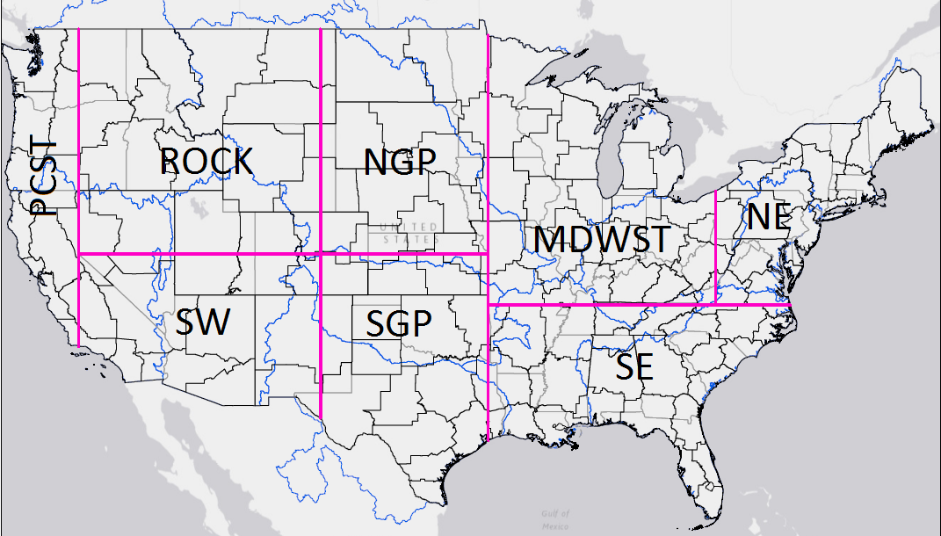
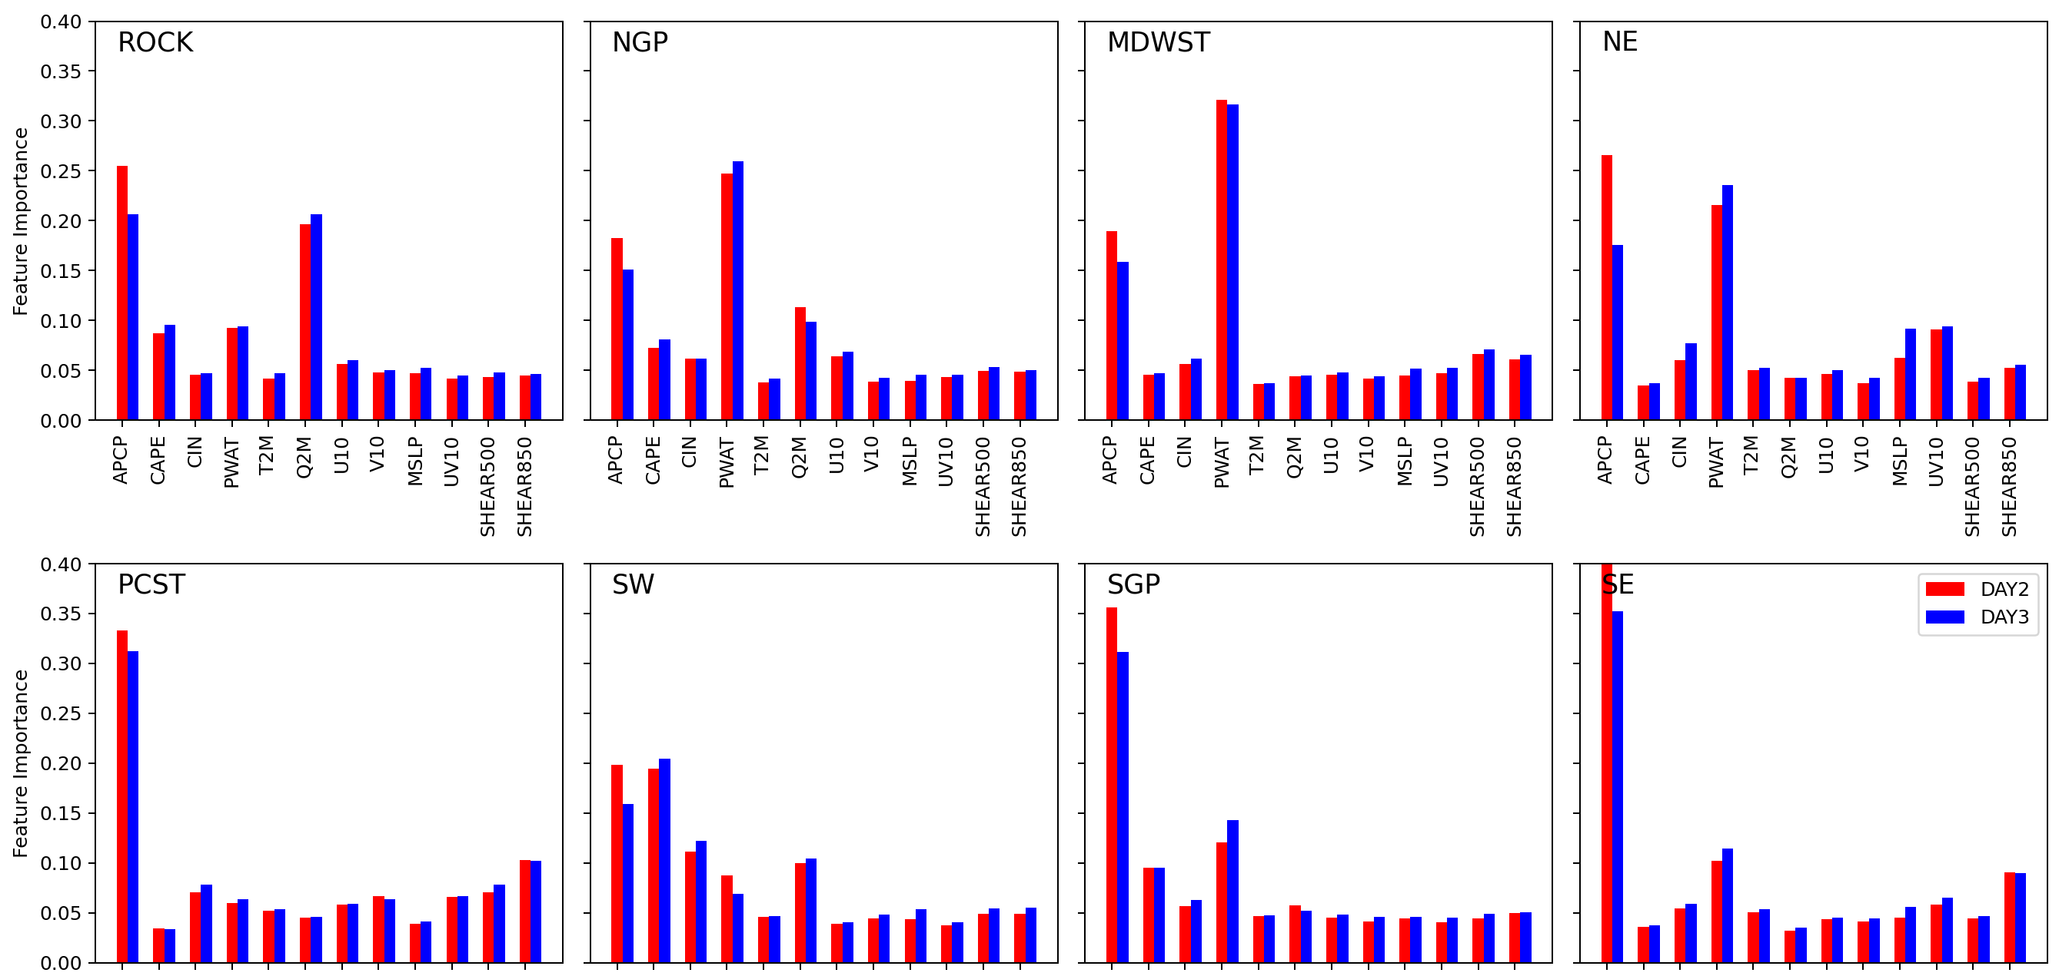
Variable Importances
Model QPF (APCP), CAPE, and PWAT most predictive of UFVS-like events in most CONUS regions
In regions where extreme precipitation driven by large-scale processes, APCP identified as even more predictive
In highly convectively active regions (e.g. NGP, MDWST), PWAT identified more predictive than APCP (or Q2M as in exceedance models)
UFVS models
ROCK
NGP
MDWST
NE
PCST
SW
SGP
SE
APCP
CAPE
CIN
PWAT
T2M
Q2M
U10
V10
MSLP
UV10
SHEAR500
SHEAR850
Bigger Number -> More Predictive

